Slide 1

FIFA Statistics and Machine Learning
Group Members: Jacob Woolley, Viktor Bondarenko, Joseph Kennedy, Micah Korinek

Slide 2

Data Source
Wanted to work with sports statistics
Difficult to find large enough datasets
Kaggle.com Sports Data Analysis Usability: 8.53
Originally from sofifa.com
Companion to video game FIFA for data on choosing players

Slide 3

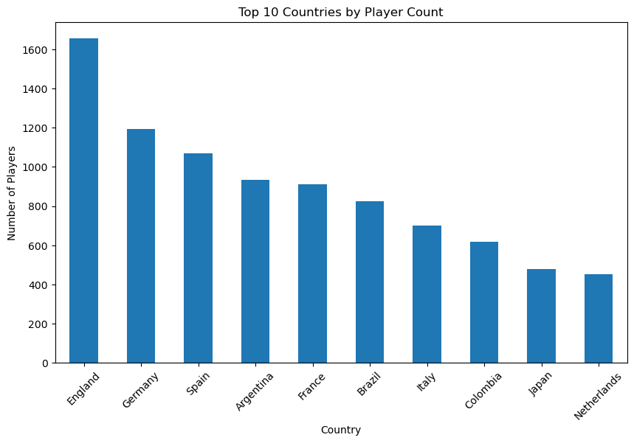
Our Dataset
Around 18,000 players
Calculating for player wage
Basic statistics (age, height, weight, etc.)
34 soccer statistics for each player (dribbling, ball control, stamina, etc.)
Rated from 1 to 100

Slide 4
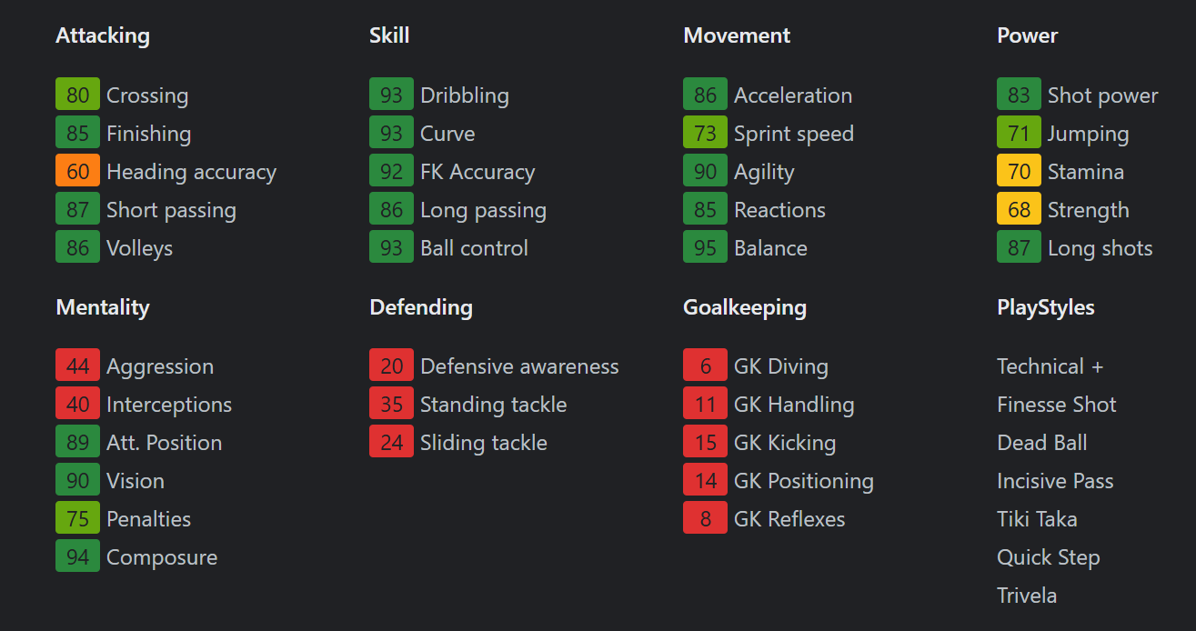
Sample Dataset: Lionel Messi

Slide 5

Our Dataset
Around 18,000 players
Calculating for player wage
Basic statistics (age, height, weight, etc.)
34 soccer statistics for each player (dribbling, ball control, stamina, etc.)
Rated from 1 to 100

Slide 6
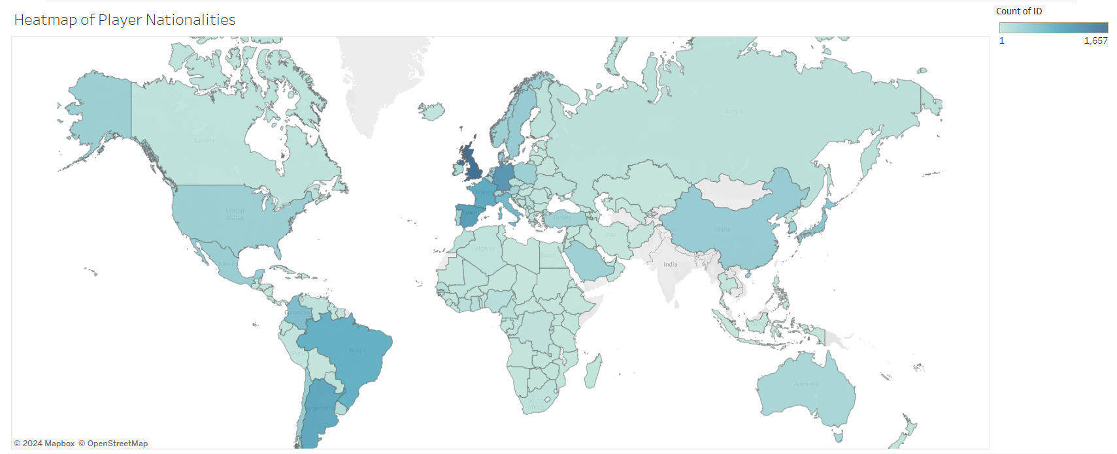
Heatmap of Player Nationalities

Slide 7
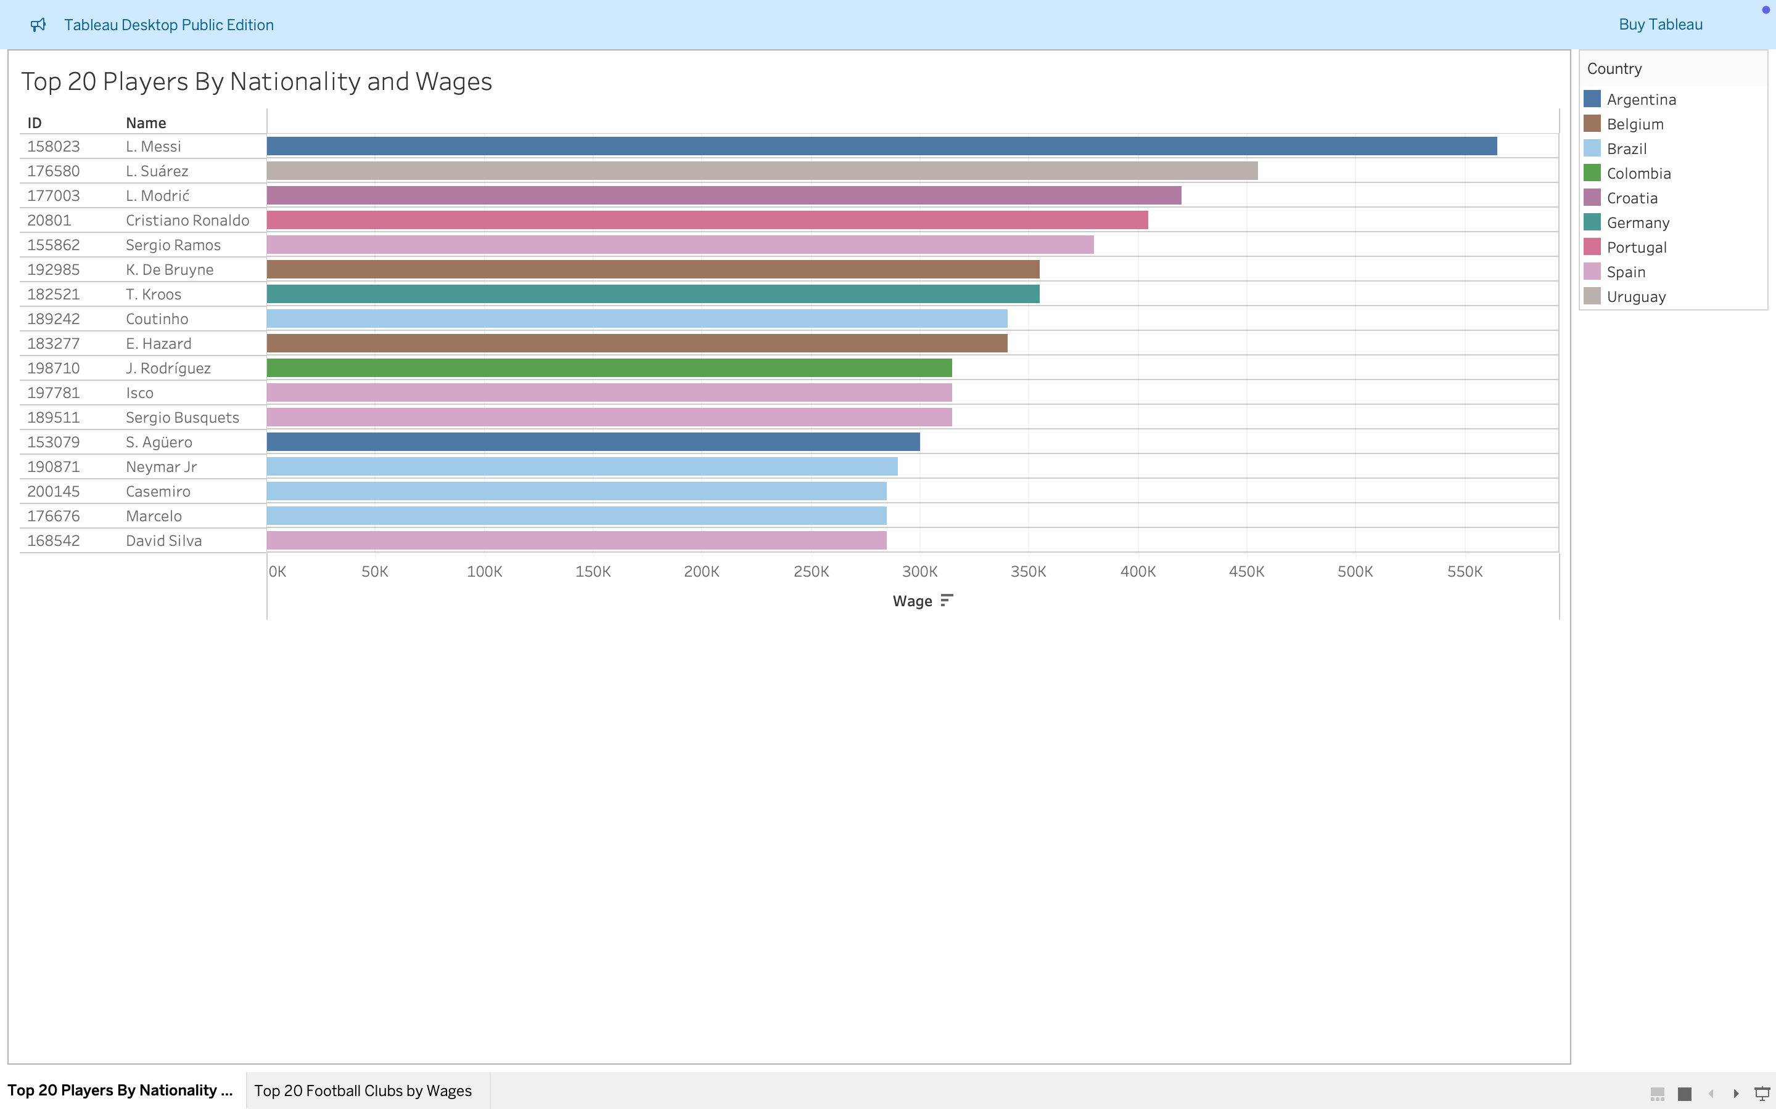
Top Paid Players by Nationality

Slide 8
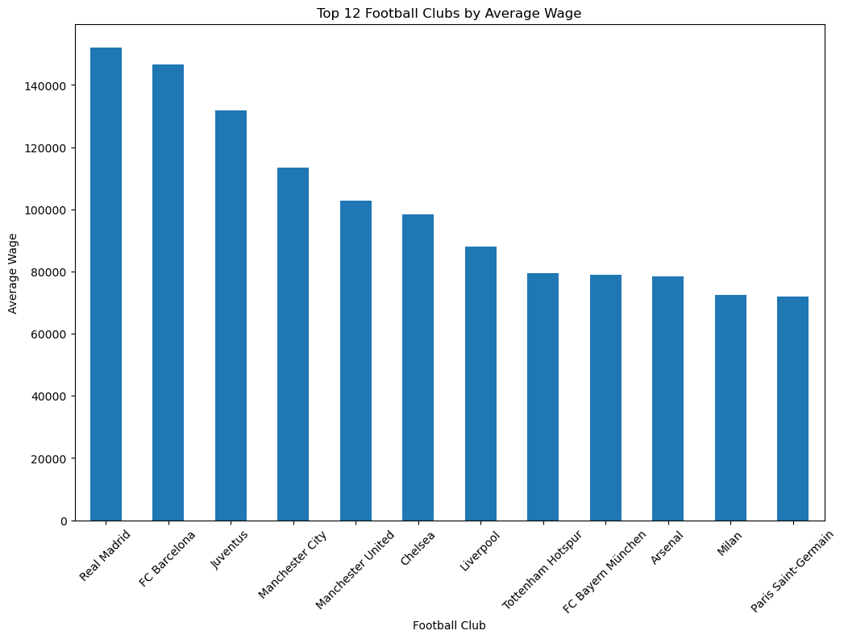
Football Clubs with Highest Average Wages

Slide 9

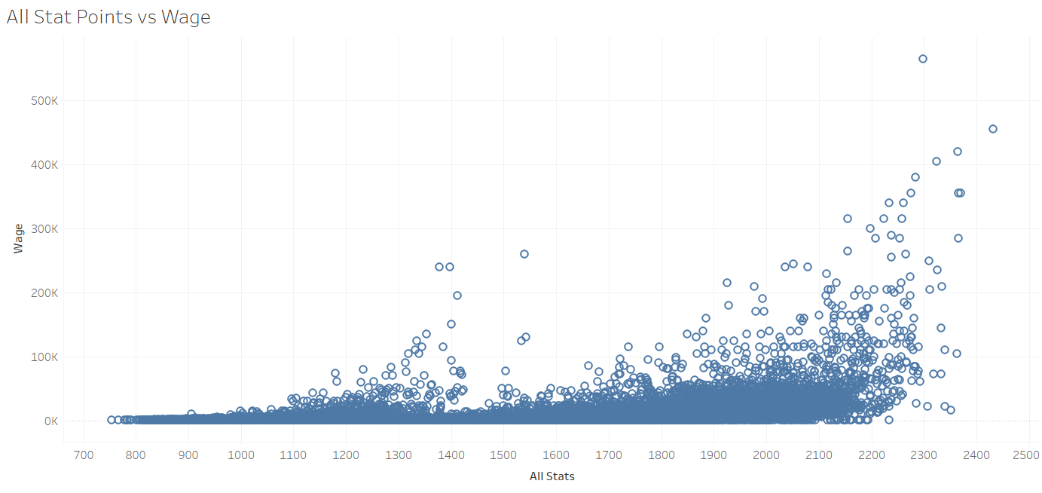
Sum of Stat Points vs Wage

Slide 10
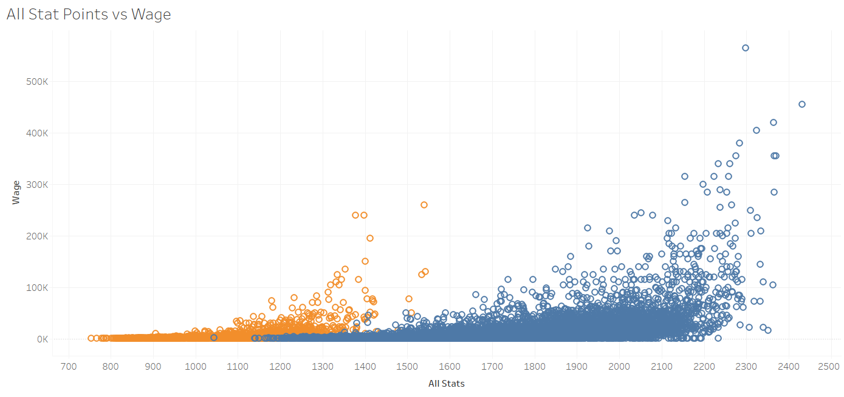
Sum of Stat Points vs Wage (Goalkeepers in Orange)

Slide 11
Football Clubs with Highest Average Wages

Slide 12
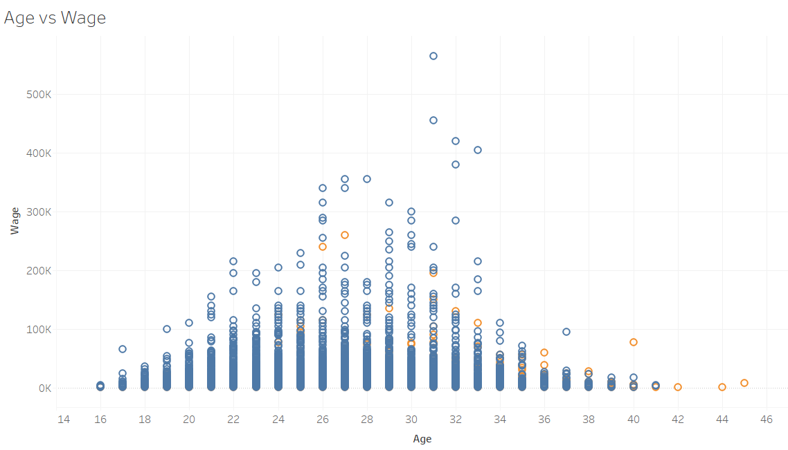
Age vs Wage

Slide 13

Cleaning the Data
Removed goalkeepers and goalkeeping data
Removed players without club affiliations/wages
Quantified dominant foot
Removed non-numeric categories
Deleted days joined column

Slide 14

Testing the Models

Slide 15
Model Results
Model | R-squared
Linear Regression | 0.533
Random Forest | 0.804
KNN 2 | 0.560
KNN 5 | 0.568
KNN 12 | 0.618
SVC Linear | 0.278
SVC RBF | 0.285
XGBoost | 0.810
Neural Network | 0.364

Slide 16

Conclusions

Slide 17
